Slide 1
TEXTILE & CLOTHING Revision of Pan-Euro-Med rules of origin
Current rules:
Dyeing is not considered as a transformation in the current rules of list, which are as follows:
For the Woven Fabrics : (5007, 5111 to 5113, 5208 to 5212, etc.) :
Manufacture from single Yarn
OR
Printing accompanied by at least two preparatory or finishing operations
For the Chapter 62 : Articles of apparel and clothing accessories, not knitted or crocheted :
Manufacture from Yarn
OR (in some cases)
Manufacture from unembroidered / uncoated fabric

Slide 2
TEXTILE & CLOTHING Revision of Pan-Euro-Med rules of origin
Current rules
Translation of the current rules in processing operations :
For Woven Fabrics :
« Spinning + Weaving » OR« Printing + 2 operations »
For the Woven Garments :
«Weaving + Making-up»

Slide 3
TEXTILE & CLOTHING Revision of Pan-Euro-Med rules of origin
OBJECTIVES :
Expand the ennoblement and finishing sector.
Increase the availability of finished fabrics locally to support the competitiveness of the industry (time optimization, simplification of sourcing, improved reliability and flexibility, ...).
FINDINGS :
The largest share of fabrics need is satisfied by imports. The limited production of Woven fabrics mainly concerns small orders.
The spinning industry as well as the weaving industry were deployed to countries with raw materials (cotton and wool).
Asian producers produce huge quantities of fabrics and have, moreover, a local production of fibers and yarns.
Knitting is a much lighter industry than the weaving. This activity may continue to grow in Tunisia.

Slide 4
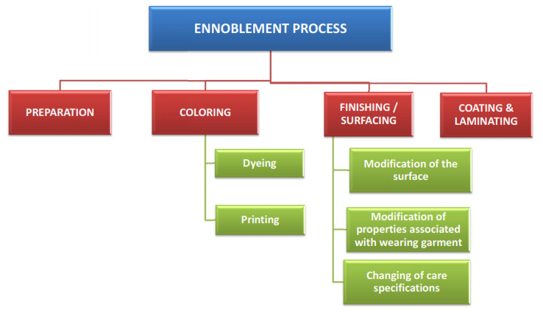
TEXTILE & CLOTHING Revision of Pan-Euro-Med rules of origin
FINDINGS :
Important added value of Ennoblement
Ennoblement = Preparing + Dyeing + Finishing (Surfacing)

Slide 5
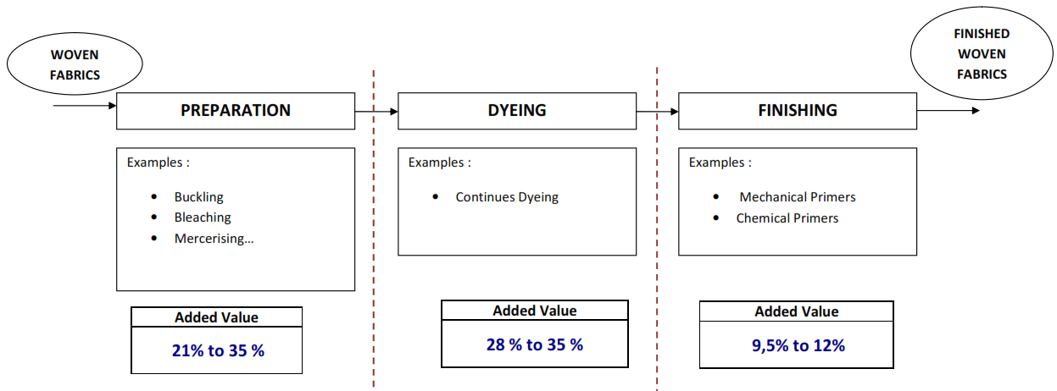
TEXTILE & CLOTHING Revision of Pan-Euro-Med rules of origin
FINDINGS :
Important value added of Ennoblement (Preparation + Dyeing + Finishing)
Synthesis of the collected examples :

Slide 6
TEXTILE & CLOTHING Revision of Pan-Euro-Med rules of origin
FINDINGS :
Important value added of Ennoblement :
Preparing + Dyeing + Finishing : Added value of 58 to 82%
Dyeing Starting greige fabrics is necessarily associated with operations of Preparation and Finishing
RESULTS :
Taken together, these findings converge on the consideration of dyeing on Woven fabrics as substantial operation, combined with making-up confer origin.
The second proposal concerns the dyeing on made-up garments, which in combination with making-up confer origin. In this case it is proposed the following path: import greige fabrics, fabric preparation in Tunisia, making-up in Tunisia, Dyeing & Finishing on made-up garments in Tunisia.

Slide 7
TEXTILE & CLOTHING Revision of Pan-Euro-Med rules of origin
PROPOSED NEW RULES:
For woven Garments (Chapter 62) :
"Manufacture from unbleached fabric“ → Dyeing + Making-up
For Woven Fabrics (5007, 5111 to 5113, 5208 to 5212, etc.) :
«Printing or Dyeing accompanied by at least two preparatory and finishing operations»
Knitted Garments (Chapter 61) :
"Manufacture from yarn“ → Knitting + Making-up

Slide 8
TEXTILE & CLOTHING Revision of Pan-Euro-Med rules of origin
FOCUS ON THE FINISHING OPERATIONS
The value of finishing operations can be very high

Slide 9
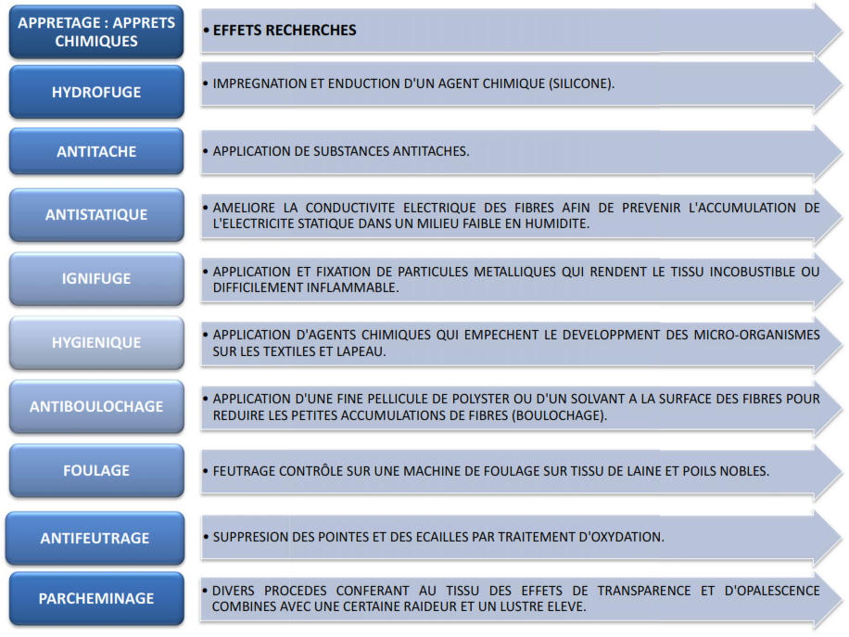
TEXTILE & CLOTHING Revision of Pan-Euro-Med rules of origin
FOCUS ON THE FINISHING OPERATIONS
The value of finishing operations can be very high

