Slide 1



Slide 2

China Smart Expo 2018
May 31-June 2
Budapest ∙ Hungary
www.chinasmartexpo.com
May 31 - June 2, 2018 ∙ Budapest

Slide 3

Our Background
  To better promote “Belt and Road Initiative” and deepen the cooperation between China-CEEC, China Smart Expo is launched as a platform, to introduce China brands and products to CEEC countries.
  Central European Trade and Logistics Cooperation Zone, the official/governmental China national-level trade and economic cooperation zone in EU, has been the main organizer of China Smart Expo for 8 year.

Slide 4
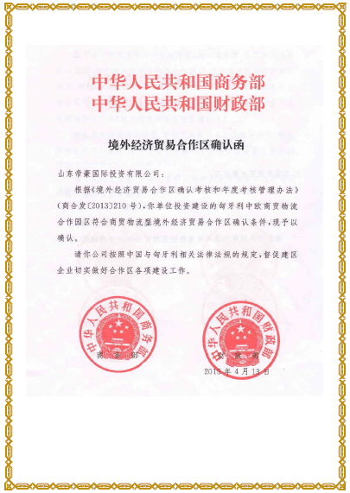
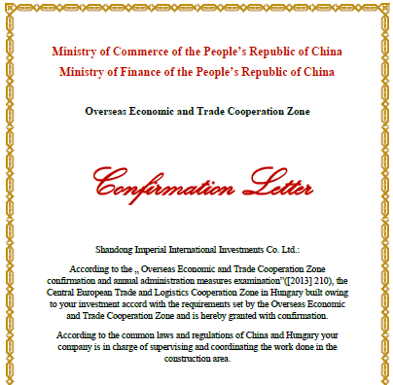
Our Background
Ministry of Commerce
Ministry of Finance
2015 April 13th

Slide 5

Our Organizer
Since 2010, China Smart Expo has been held yearly in Budapest, Hungary, for the past 8 years.
  Hosted by Ministry of Commerce of People’s Republic of China
  Organized by Trade Development Bureau of Ministry of Commerce of China
  Co-organized by China Center for International Economic Exchange, Central European Trade and Logistics Cooperation Zone
  Supported by Embassy of the People’s Republic of China in Hungary, Hungarian Investment Promotion Agency, ChinaCham Hungary
  Supported by departments of commerce of different provinces and cities in China
  All Chinese exhibitors are authorized by Chinese government and can be 100% trusted

Slide 6





Our Organizer

Slide 7

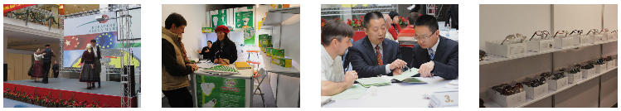
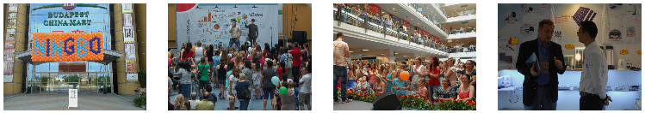
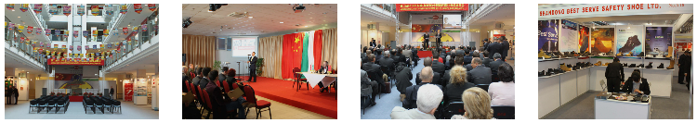
Our History
2010
June, Light Industry Exhibition and Trade Fair
2011
June, Ningbo Exhibition
2012
April, Linyi and Shandong Exhibition

Slide 8
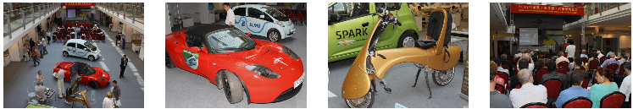
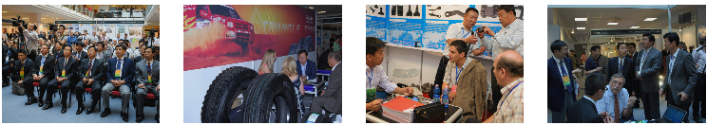
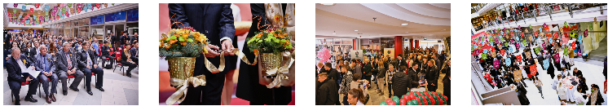
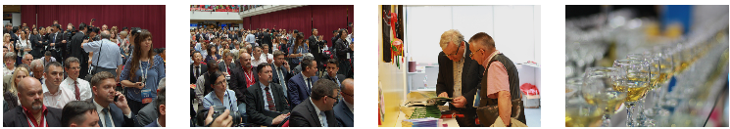
2012
June, China Automotive Parts Exhibition
2013
June, China Smart Expo
2014
November, China Smart Expo
2015
June, China Smart Expo

Slide 9
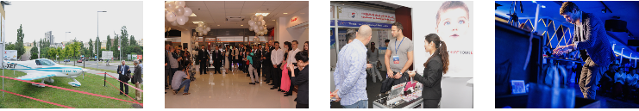
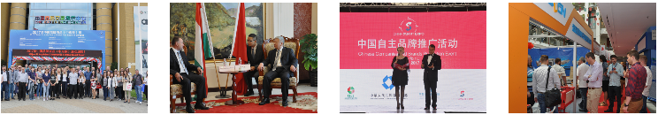

2016
June, China Smart Expo
2017
May 31st – June 2nd , China Smart Expo
2018, May 31st – June 2nd , China Smart Expo
Budapest, Hungary
2018

Slide 10
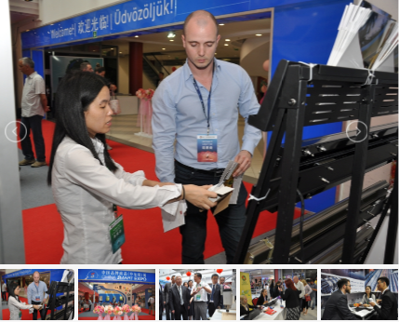
2017 Highlights
300 Chinese exhibitors are endorsed by departments of commerce of certain provinces
12 industries, thousands of available goods
4300+ registrants
2000 match-making points booked and implemented
Visitors came from Hungary, Serbia, Slovakia, Romania, Slovenia, Croatia, Czech Republic etc...

Slide 11
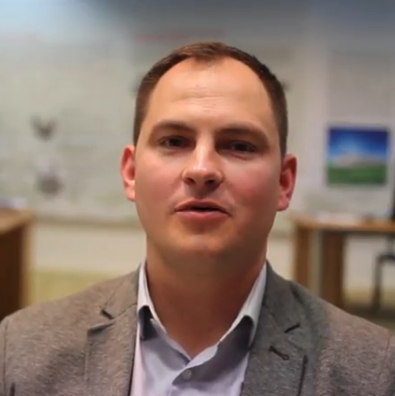
Successful Story
Hungarian Buyer
HAMARBARKÁCS KFT.
“We have about 500 retailers in Hungary. We made a business connection with the Chinese company Max Power during 2017 China Smart Expo. “

Slide 12
Our Partners
China Smart Expo partners with chambers/associations of commerce, industry, agriculture, automotive, handcraft in each CEEC country
In Hungary, we have connection with Hungarian Investment Promotion Agency, ChinaCham, Hungarian National Trading House, Hungarian Packaging Association, Chamber of Commerce of Pest County, Association of Hungarian Automotive Component Manufactures
Besides Hungary, We have also developed connection with chambers/associations in Croatia, Romania, Serbia, Slovakia, Slovenia, Ukraine and Poland

Slide 13
















Our Partners (part)

Slide 14
What’s New in 2018?
All in
One
China Export Brand Fair
Shandong-CEEC Education Fair
Shandong-CEEC International Copyright Trade Exhibition
Shandong-CEEC International Tourism Exhibition
Shandong-CEEC International Sports Industry Exhibition
China Import Fair

Slide 15
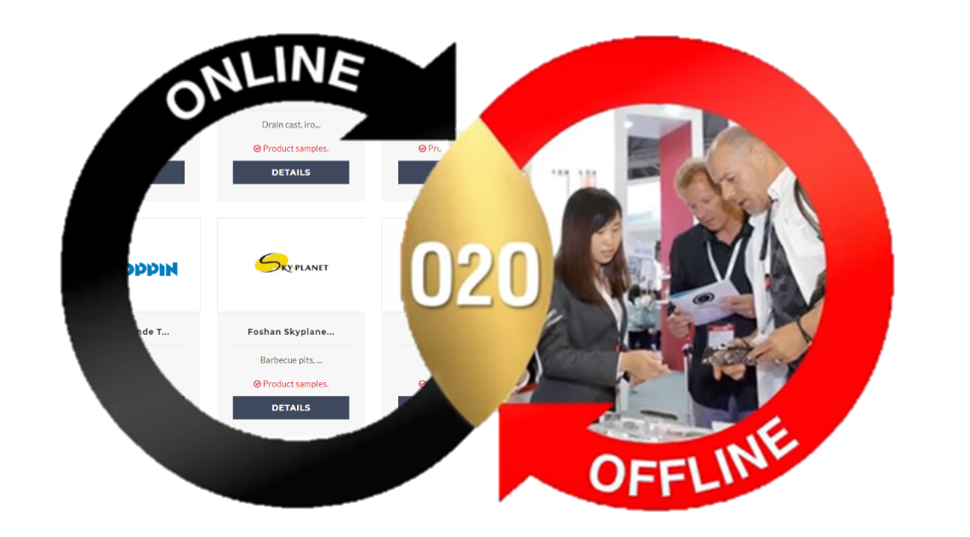
Online to Offline
Online: Online match-making Meeting
See the newest products from our expo year-around http://www.chinasmartexpo.com
Offline: Maximize your visit at our expo-- save your favorite exhibitors and book a meeting timeslot

Slide 16
China Export Brand Fair
300 Chinese exhibitors authorized by departments of commerce of certain provinces and cities
12 industries including electronics, home appliance, building materials, furniture, hardware, LED & Lighting, machinery, textile, agriculture product, chemicals, etc.
Language barrier? We provide EN-CH or HU-CH interpreters free of charge
Maximize your visit: Pre-study interesting products at chinasmartexpo.com, book a timeslot with your preferred exhibitors, then verify their products at China Smart Expo 2018 and negotiate your business deal

Slide 17




All in One Expo
(The Culture Expo of Confucius's Hometown-Shandong)
Education
Copyright
Tourism
Sports
May 31-June 2
May 31-June 2
May 31-June 2
May 31-June 2
Chinese Language
Chinese Medicine
Economics and Business
E-commerce
Vocational technology
sports culture
sports products & manufacturing
sports tourism
sports events
news publishing
video & music
anime & games
arts
Tourist sites from Jinan, Zibo, Dongying, Yantai and Weihai
travel agencies

Slide 18
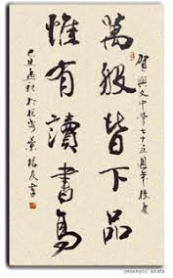
2018 Shandong-CEEC Education Fair
Purpose: to promote “Study in Shandong” in CEEC region
Organizer: Department of Commerce of Shandong Province
Shandong Provincial Education Department
Cooperation fields: Chinese Language, Chinese Medicine, Economics and Business, E-commerce, Vocational technology
Students exchange, Intercommunication, Long and short term training course
Decision-maker and representatives from approx.20 colleges and universities from Shandong province will attend and seek education field cooperation.
20 exhibitors

Slide 19

2018 Shandong-CEEC International Copyright Trade Exhibition
Purpose: to extend the cooperation of copyright fields between Shandong province and CEEC regions, to realize copyright authorization and transfer between Shandong-CEEC
Organizer: Department of Commerce of Shandong Province
Copyright Administration of Shandong Province
Cooperation fields: news publishing, video & music, anime & games and arts
20 exhibitors

Slide 20

2018 Shandong-CEEC International Tourism Exhibition
Purpose: to promote Shandong tourism industry in CEEC region and attract more tourists from CEEC region
Organizer: Department of Commerce of Shandong Province
Shandong Provincial Tourism Development Commission
Cooperation fields: Tourist sites from Jinan, Zibo, Dongying, Yantai and Weihai city, travel agencies
20 exhibitors

Slide 21

2018 Shandong-CEEC International Sports Industry Exhibition
Purpose: to extend the cooperation of Sports Industry between Shandong province and CEEC region
Organizer: Department of Commerce of Shandong Province
Shandong Provincial Sports Bureau
Shandong Sports Industry Development Service Center
Cooperation fields: sports culture, sports products & manufacturing, sports tourism, sports events, sport clubs
20 exhibitors

Slide 22

China Import Fair
“2018” is called China Import Year. International Import Expo in Shanghai is the most significant diplomacy projects initiated by China central government
Chinese companies organized by Department of Agriculture and Trade of Shandong province are ready to purchase in agriculture & food industry from CEEC regions during China Smart Expo 2018
A conference will be organized during this fair to have direct business relationships for you to your potential Chinese buyers.

Slide 23
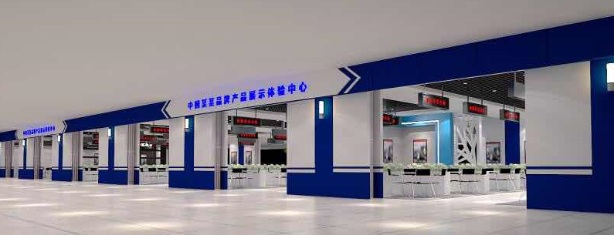
2018 Booth Plan
8000+ M2 booth area
300+ comprehensive international trade company booths
around 80 culture expo booths (education, copyright, tourism, sports)

Slide 24




China Smart Expo 2018
Date & Time: May 31-June 2
Opening hours: 10.00-16.00
Budapest ∙ Hungary
1152 Budapest Szentmihályi út 171.
www.chinasmartexpo.com
Free entrance for registrants only,
See you there!

